Slide 1



CAPSTONE
PROJECT

Slide 2



THE TEAM
B vinay kumar
A S Chanakya
G Karthikeyan

Slide 3



INTRODUCTION
Overview of Domain-Specific Languages (DSLs) and their significance in contemporary software development.
Importance of dedicated DSL compilers for translating high-level DSL code into machine-executable instructions

Slide 4
PROBLEM
STATEMENT
Challenges in designing a robust front-end for a DSL compiler, including lexical, syntax, and semantic analysis complexities

Slide 5

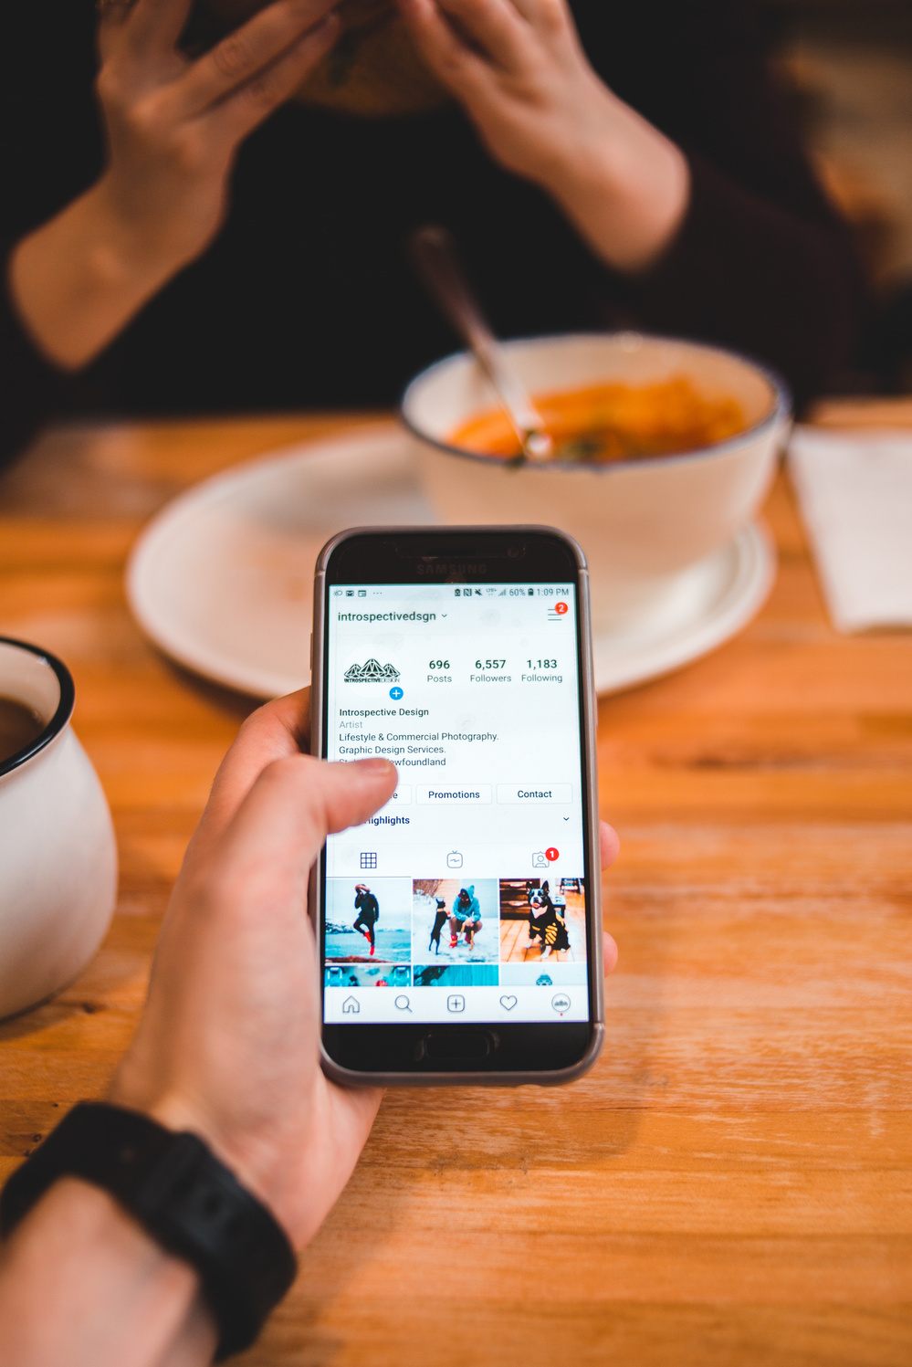
OBJECTIVES
Primary objectives of the project, such as creating an effective front-end for a DSL compiler, integrating register allocation mechanism, and investigating machine learning techniques for compiler optimization

Slide 6
METHODOLOGIES:
Approaches used to attain project objectives, including literature review, front-end design, register allocation technique, and machine learning integration

Slide 7
LITERATURE
Insights from previous research on DSL compilers, emphasizing the significance of front-end design, semantic analysis, and syntax analysis

Slide 8
IMPLEMENTATION DETAILS
Information on the implementation of various components, including the programming language and tools used, handling of DSL grammar details, and generation of intermediate representation.

Slide 9
INTRODUEXPERIMENTAL SETUPCTION
Details of the hardware and software environment used for testing the DSL compiler's performance under various conditions

Slide 10
RESULTS AND ANALYSIS
Examination of experimental data to assess the effectiveness of compiler design decisions and optimizations

Slide 11
SAMPLE INPUT AND OUTPUT
Code samples showcasing the DSL code and corresponding results

Slide 12
CHALLENGES AND FUTURE WORK:
Discussion of project problems, potential future directions, and upgrades ,Future work may include

Slide 13
CONCLUSION
APPENDICES
Summary of major discoveries, contributions to DSL compiler design, and opportunities for development
Inclusion of code samples, comprehensive experimental data, and other relevant information for reference

Slide 14



THANK YOU!

